Slide 1

Hand drawn Multi Digits Recognition
Prepared by Mohamed Suhaib

Slide 2
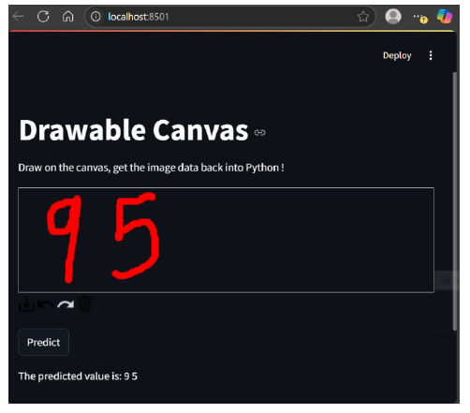
Problem Statement
The goal of this hackathon is to use neural networks and computer vision to predict hand drawn digits. This means you have to create a drawing canvas to draw digits and identify/predict what are the digits drawn.

Slide 3
Scope of this project
You’ll be using the MNIST digits Dataset from keras library. The dataset contains hand written digits images:
• MNIST is a collection of handwritten digits ranging from the number 0 to 9.
• It has a training set of 60,000 images, and 10,000 test images that are classified into corresponding categories or labels.
• To use the MNIST dataset in Keras, an API is provided to download and extract images and labels automatically (refer below statements).
from keras.datasets import mnist
mnist.load_data()
Data set provided
Training set - 60000
Test dataset - 10000

Slide 4
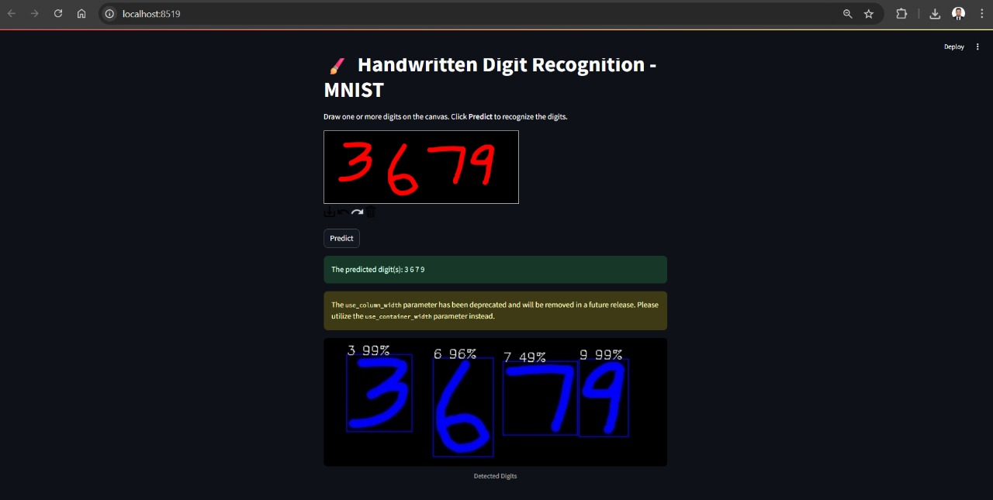
Prediction1:

Slide 5
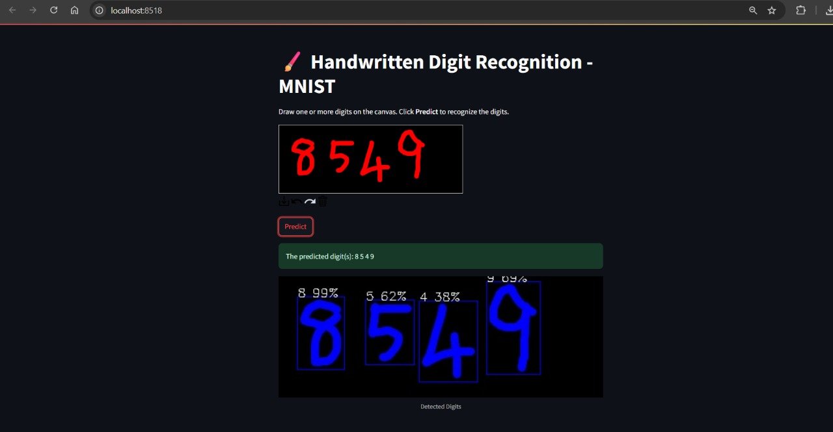
Prediction2:

Slide 6
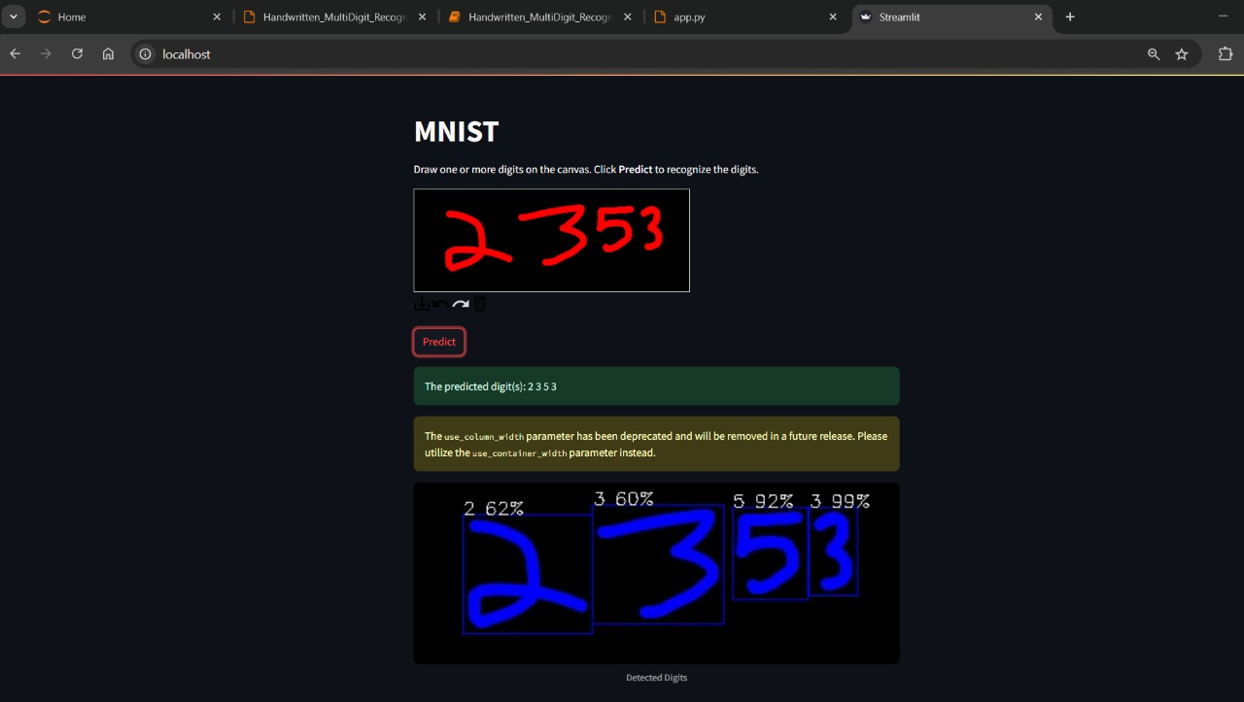
Prediction Using Docker Build:

Slide 7

Cloudrun Deployment: URL: https://dhack2025-104870083721.Europe-west1.run.app

Slide 8
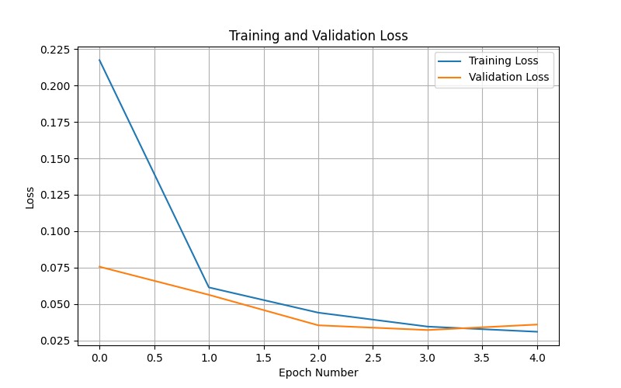
Training and Validation Loss:

Slide 9
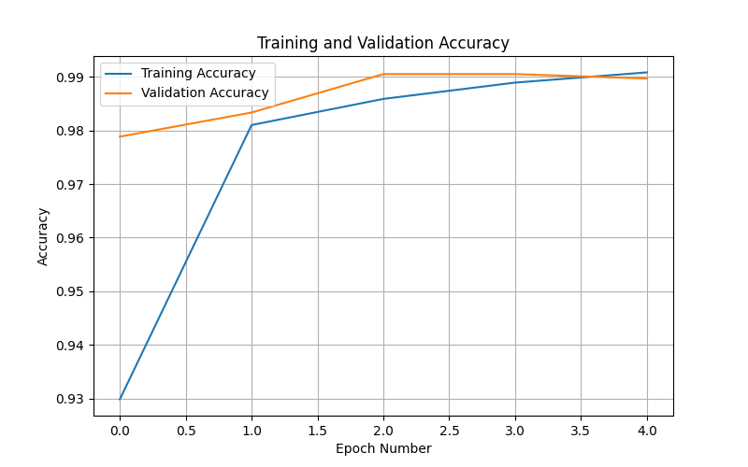
Training and Validation Accuracy

